Slide 1

Simple Harmonic Motion
Group-06

Slide 2
INDEX
Definition
Condition for S.H.M
Displacement
Velocity
Acceleration

Slide 3
Definition
Such a motion in which acceleration is directly proportional to the displacement and is directed towards the mean position is called simple harmonic motion(SHM).

Slide 4
CONDITION FOR S.H.M. :
The system should have restored force
The system should have inertia
The system should be frictionless

Slide 5
why S.H.M. is important ?
The study and control of oscillation are two of the primary goals of both physics and engineering.

Slide 6
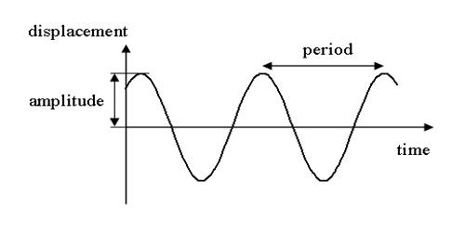
Displacement

Slide 7
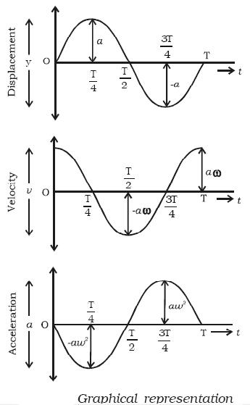
Velocity

Slide 8
Acceleration

